Slide 1
Exoplanets: Discovery and computational Methods
George Vassilakis

Slide 2
Introduction
Exoplanet: A planet that orbits a star that is outside our solar system. (A.K.A. an “Extrasolar Planet”)
According to NASA, there have been over 4,500 experimentally verified exoplanets.
Still more to verify
These discoveries raise a couple of questions:
How are astronomers discovering these planets?
What type of data and information do they receive to deduce it as an exoplanet?
What is the purpose of finding these planets?

Slide 3
Historical and Background information
Van Maanen 2 Discovery (1917)
PSR B1257+12 (1992)
Millisecond Pulsar (T = 6.222 milliseconds or 9,650 RPM)
First experimental evidence of an extrasolar planet
Pulsar Timing Method
51 Pegasi (1995)
First discovery of a planet orbiting a main sequence star
Radial Velocity Method

Slide 4
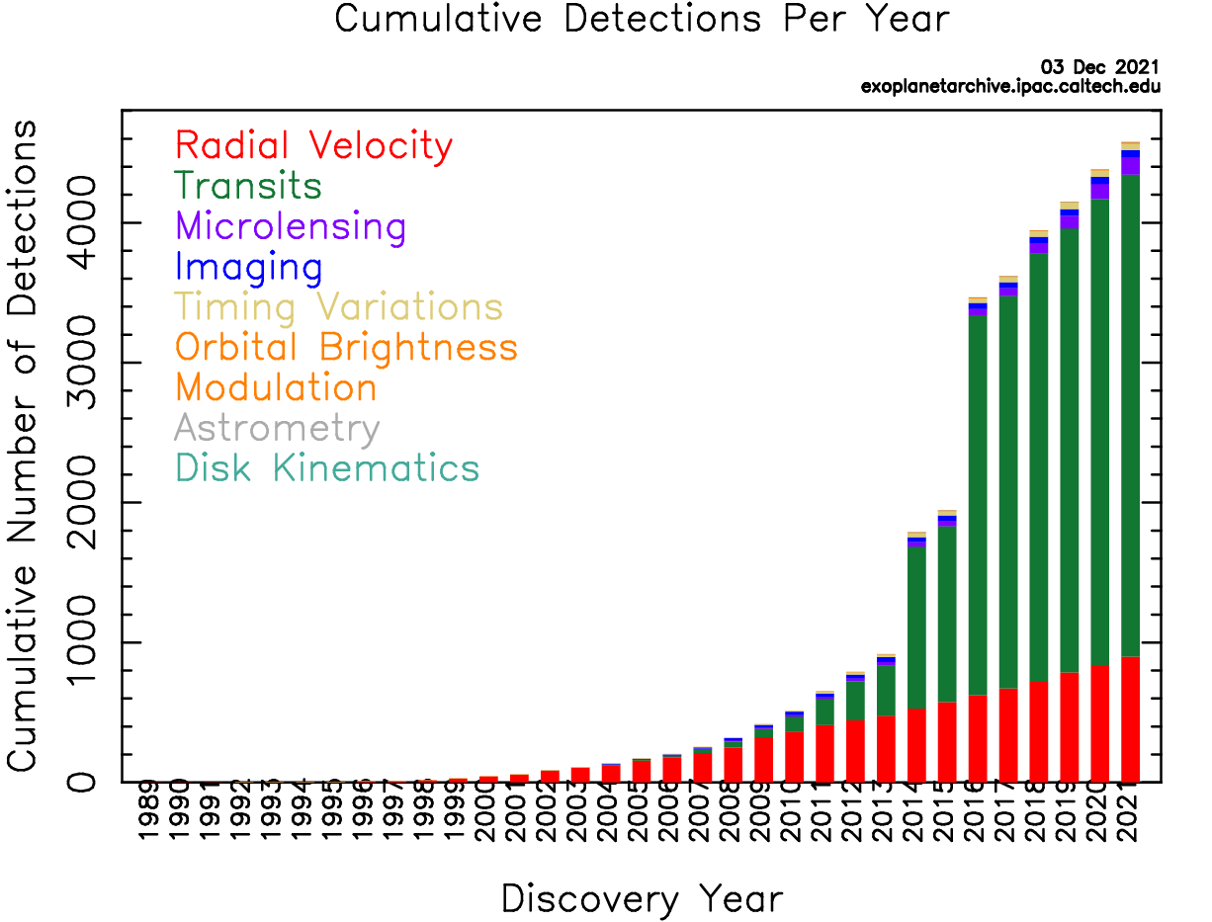
Methods of Discovery And Interpretation
Prominent Methods in order of most planets discovered:
Transit Method: 3,445 Planets
Radial Velocity (Doppler Spectroscopy Method): 899 Planets
Microlensing: 210 Planets
Direct Imaging: 54 Planets
Timing Variations: 47 Planets

Slide 5
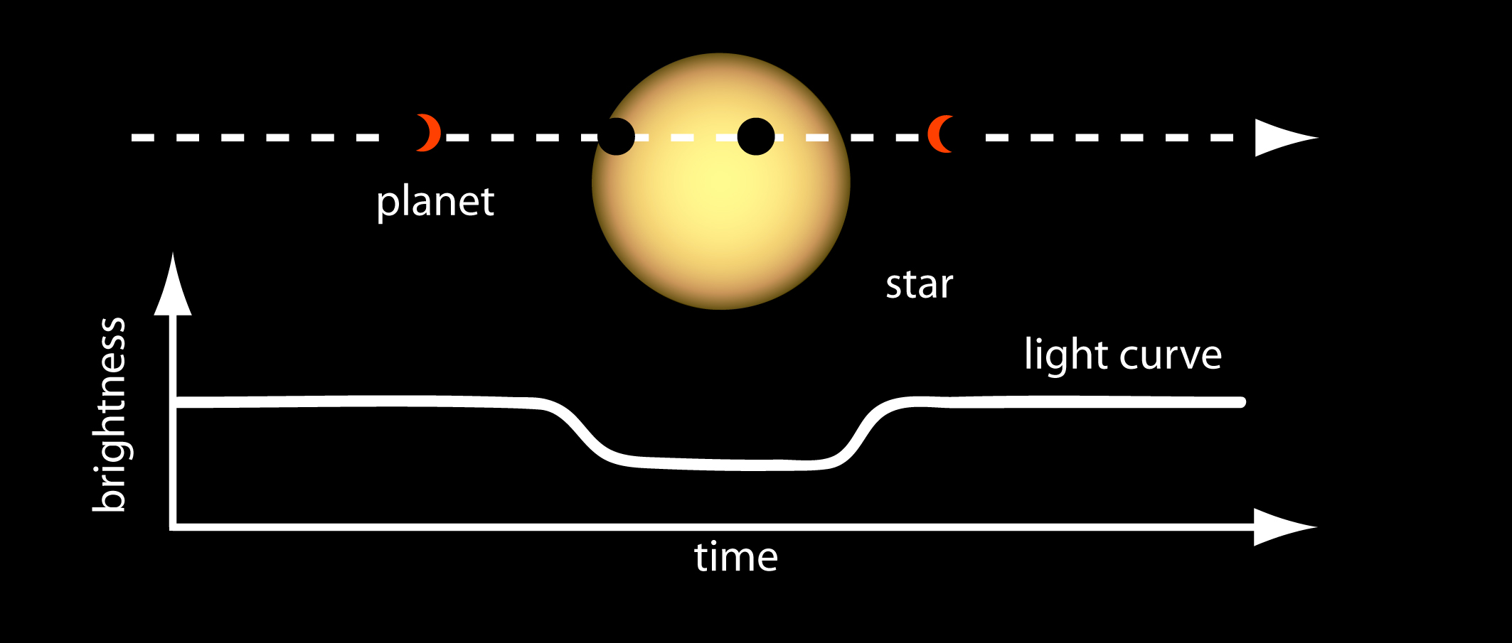

Transit Method
Transit: When a planet passes in front of a star
Transit Method: When a planet passes in front of a star, it causes a dip in luminosity, which we can measure and interpret as a passing planet.
From a single passing, we can deduce the radius of the planet based on the radius of the star
$Depth=({\frac{Rplanet}{Rstar})}^{2}$

Slide 6

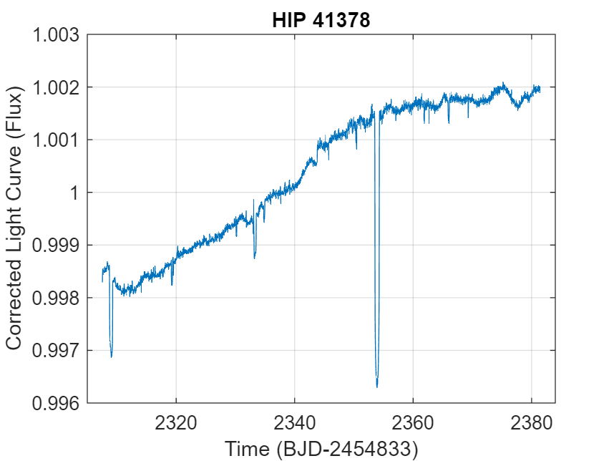
HIP 41378
Example 1: HIP 41378
378 light years away, in the constellation of Cancer
K2 Mission observed the light curves of this star between April 29th, 2015, and July 10th, 2015.
Showed an observation of a transiting exoplanet very clearly

Slide 7
HIP 41378
Depth of Light Curve: 0.525% luminosity dip
Radius of Star: 1.307 Solar Radii
Using aforementioned equation, we can determine the radius of this planet to be 40,983 miles.
Jupiter Radius: 43,411 miles
Use a function in Matlab, this calculation can be done for us.
Plotted using simple Matlab plot(x,y) tool

Slide 8
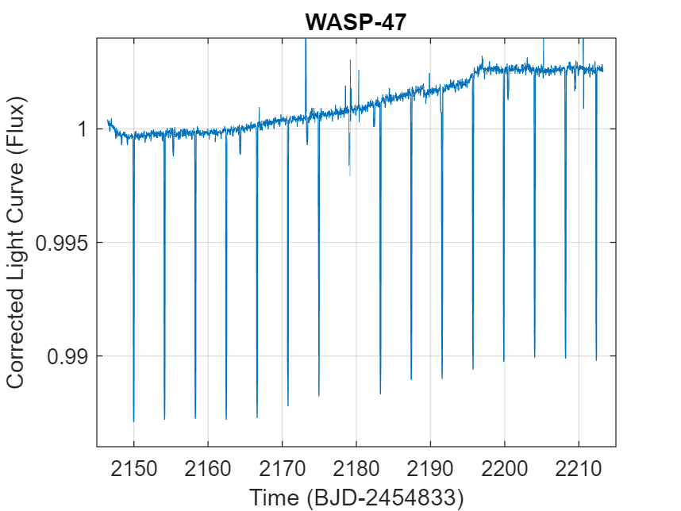
Wasp-47
Example 2: WASP-47
Main Sequence Star 870 light years away in the constellation Aquarius
K2 Mission observed measurements between November 17th, 2014, and January 23rd, 2015
Gives an example of a very periodic planet moving around the star.

Slide 9
Wasp-47
Using the depth, we can deduce the radius
R = 53,343 miles or 1.229 Jupiter Radii
Now that we have the orbital period (4.159 Days), we can also determine the orbital radius of the planet using Kepler’s and Newton’s Laws.

Slide 10

Derivation and Interpretation of Data
Kepler’s Third Law states: $\frac{T^{2}}{R^{3}}=K$, where K is a constant that depends on the system.
What is this constant?
It can be derived using Newton’s law of gravity, and centripetal force equations.
K = $\frac{4π^{2}}{GM}$, where G is the Gravitational constant, and M is the mass of the star
Using MATLAB functions to do the math, we determine the Keplerian constant K = $2.7552 ×{10}^{−19}$
Now using Kepler’s Third Law and a period of 4.159 days, we can deduce the orbital radius of this exoplanet to be 7,767,500 km, or 5.192% the orbital radius of Earth.
This shows a violently orbiting Jupiter-like gas giant, orbiting its star every 4.159 days at a radius of about 7 million kilometers.

Slide 11
Radial Velocity Method
Relies on the mutual gravitational pull of a planet-star system
Star orbits the gravitation center of the system
When the planet moves towards and away from us, the light spectrum changes, allowing us to calculate the velocities of the star.

Slide 12
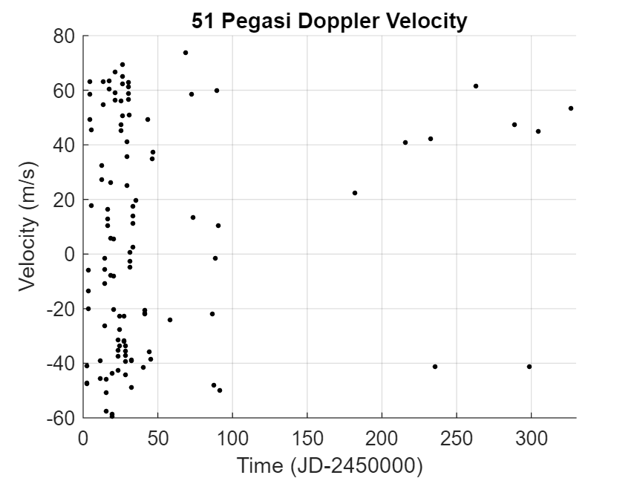
51 Pegasi
Example 3: 51 Pegasi
As mentioned before, this was the first planet discovered around a main sequence star.
Located 50.45 light years away, in the constellation of Pegasus
Observed in the Lick Observatory (CA) from October 12, 1995, to August 31, 1996.
Radial velocity measurements shown to the right.

Slide 13
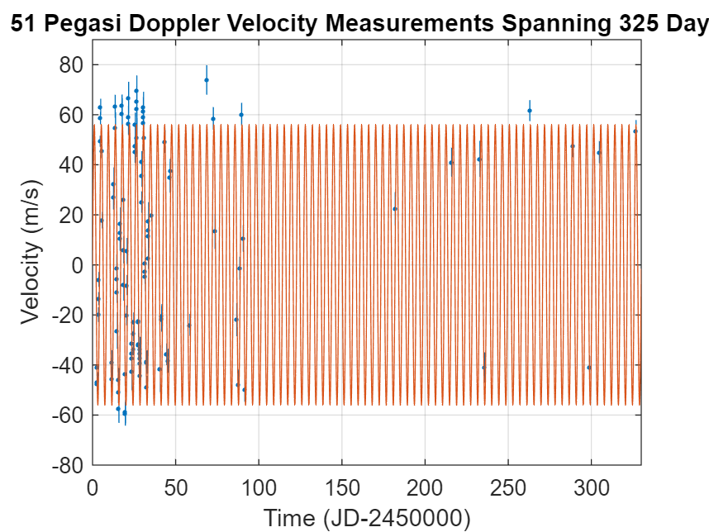
51 Pegasi
When fitted with a Keplerian orbital sinusoidal curve, the data fits quite well.
Error Measurements given in this plot as well.
Plotted in MATLAB, using the errorbar(x,y,error) function, where you can make a scatterplot with error bars.
Used the hold function in order to plot the sinusoidal curve behind the data
Still hard to see.

Slide 14
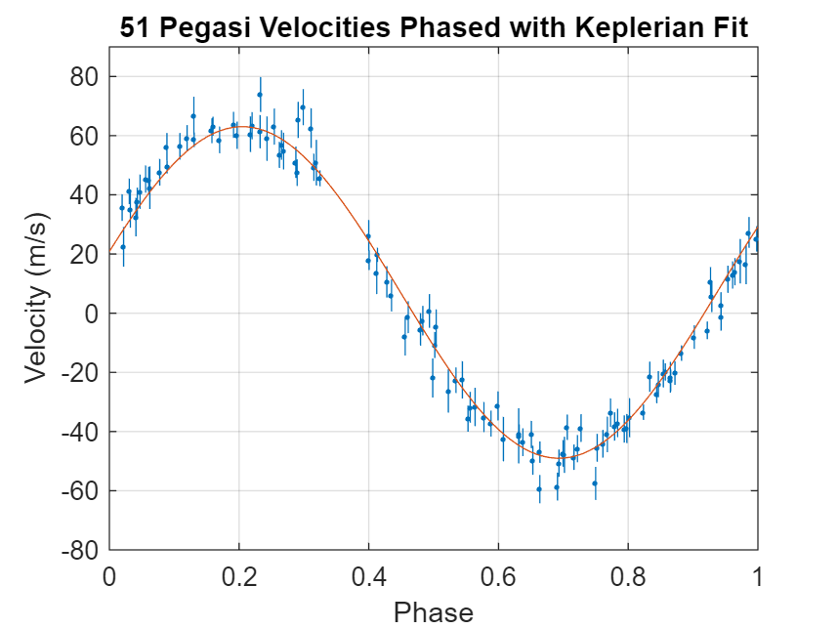
51 Pegasi
Now, we can phase the data together.
Using the mod function, we divide the time of measurement by the period of 4.231 days, which gives us the remainder.
Next, we divide the remainder by the period again, in order to get the proportion, as a value from 0-1, which is interpreted as its point in the phase.
As seen on the right, the graph shows the correlation much easier.
The periodicity of the star is maintained through nearly a year of measurements

Slide 15

Derivations and Interpretations
As mentioned before, when we have the period of the planet, we can deduce the orbital radius.
Also, we can determine the orbital velocity of the planet and the mass of the planet
Using the methods before, we use MATLAB to do the math for us, and we deduce the orbital radius to be about 7,928,800 kilometers, or 5.286% the orbital radius of Earth.
Using the equation for orbital velocity ($v=\sqrt{\frac{GM}{r}}$ and the solar mass of 1.11, we can deduce the orbital velocity of about $1.3628 ×{10}^{5} m/s$.
Now, using momentum conservation between the planet and star, we can deduce the mass of the planet.
Using Pplanet = Pstar, we can deduce that M$planet=\frac{Mstar×Vstar}{Vplanet}$
Given the amplitude of the best fit curve, which is the average maximum orbital velocity of the planet at 56.04 m/s, and the aforementioned speed of the planet, we can deduce the mass of the planet to be $9.0788 ×{10}^{26}$kg, or 0.47833 times the mass of Jupiter.

Slide 16
Why find Exoplanets?
Humans are explorers, and exoplanets are the new frontier.
Before 1992, we had only eight planets to study.
Now, with over 4,500 planets, we have exponentially more knowledge about the origins or stars, planets, solar systems, and ultimately the universe.
If we cannot find life in our solar system, the next place to look is on exoplanets.
In the Kepler mission alone, there are 361 candidates and confirmed planets that reside in the habitable zone

Slide 17
Questions?

